Slide 1




AI-assisted
Programming
Applications,
User Experiences,
Neuro-symbolic techniques
LOW-CODE USERS
DATA SCIENTISTS
DEVELOPERS
STUDENTS
Sumit Gulwani
PROSE team @ Microsoft
Marktoberdorf Summer School
Aug 2024

Slide 2
AI-Assisted Programming
Lectures organized by
Lecture 1:
Lecture 2:
Lecture 3:
Lecture 4:
Forms of intent expression
Logical Specifications
Input-Output Examples
Static or Temporal Context
Broken Programs
Natural Language

Slide 3
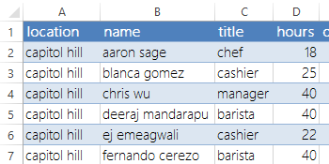
Programming by Natural Language
Some tasks like queries are best described using natural language.
    “sum the hours for the capitol hill location cashiers”
    “total hours capitol hill cashiers”
    “sum column D where column C is cashier and A is capitol hill”
    Domain-specific investments: task dataset + model training.
    Challenge: Too much variability in NL description.
[SIGMOD 2014: NLyze: interactive programming by natural language for spreadsheet data analysis]

Slide 4
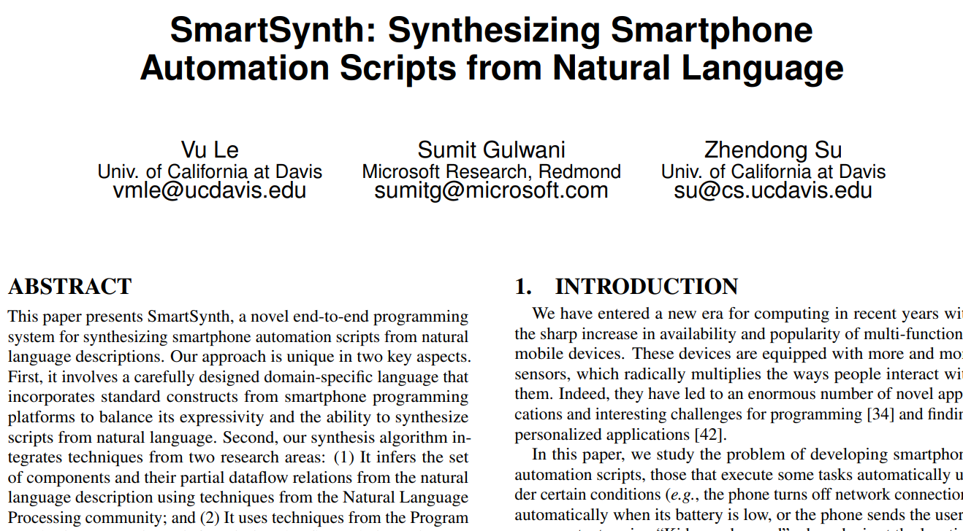
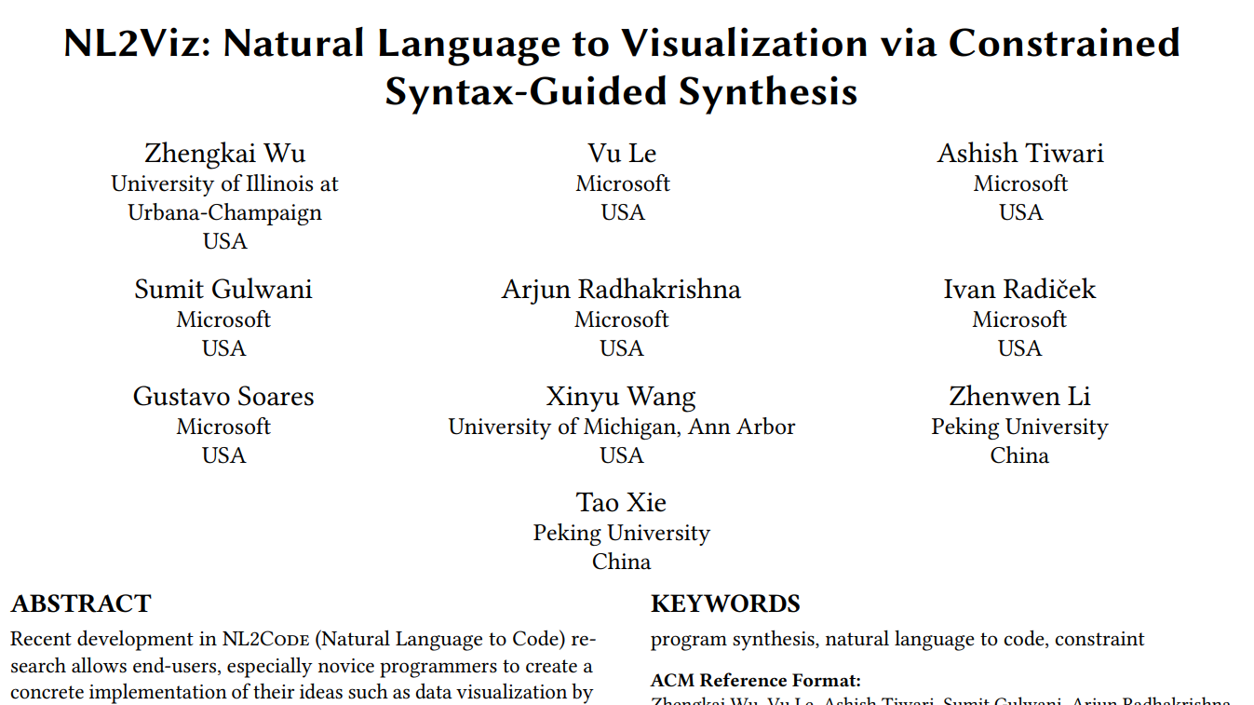

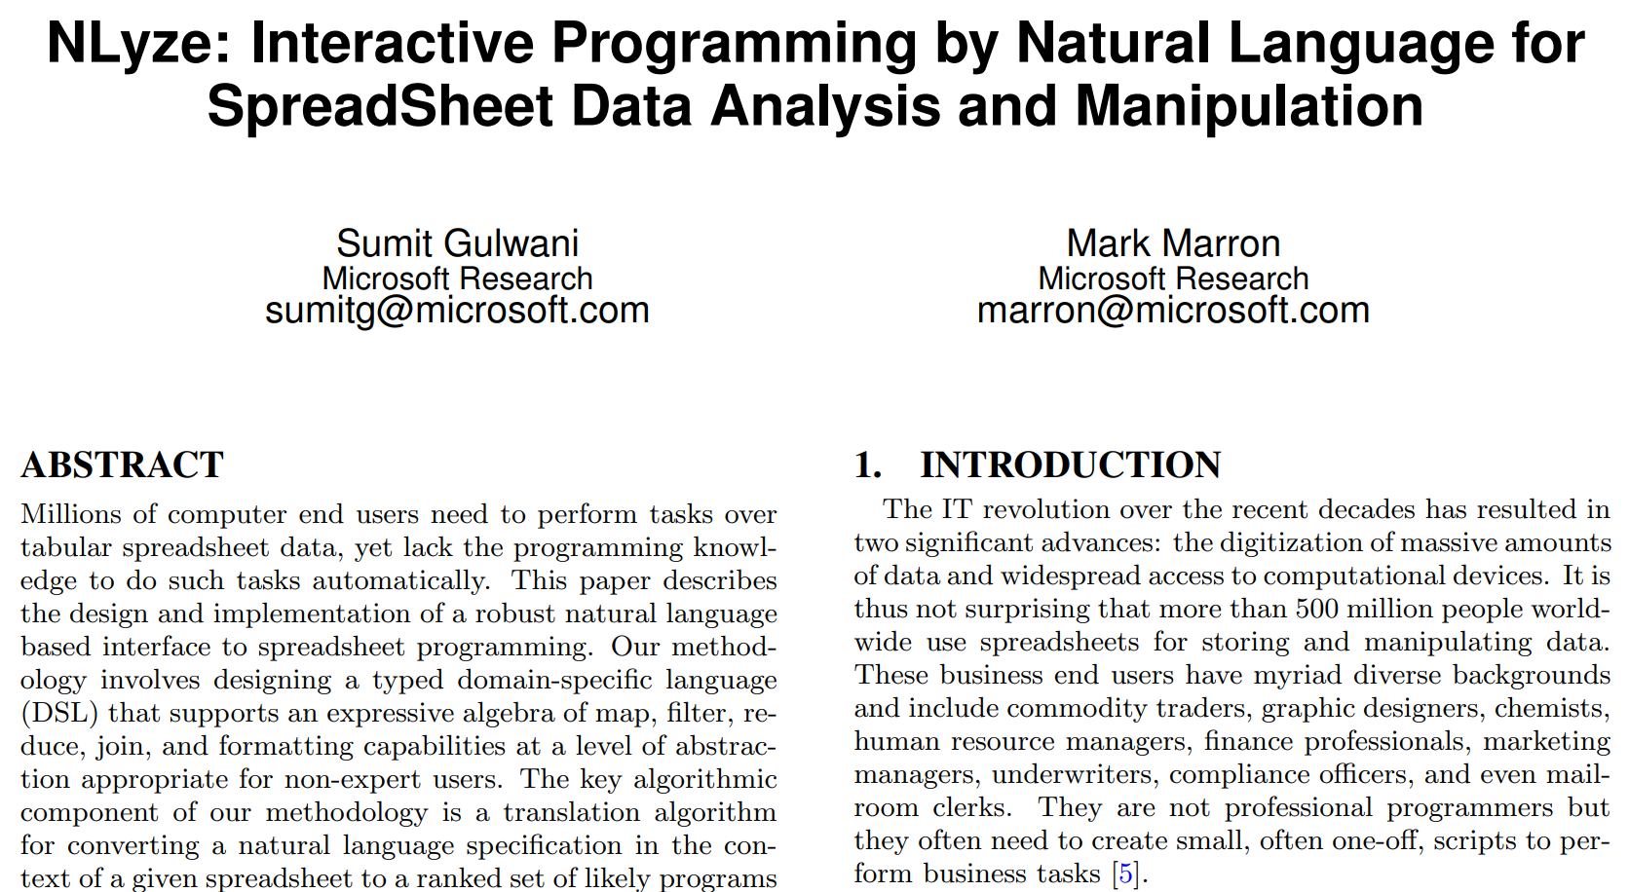
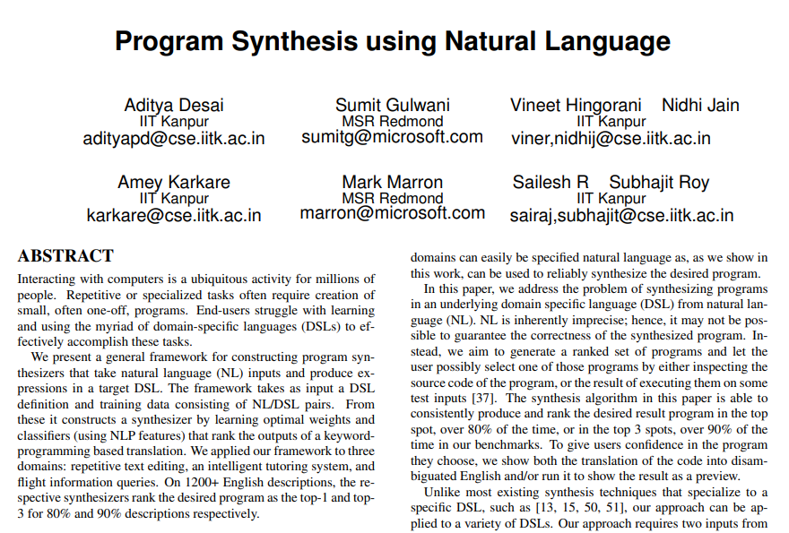

Slide 5
Lecture 4: Programming by Natural Language
Prompting
Example & Document selection for in-context learning

Slide 6

Target Similarity Tuning
Sentence BERT picks examples from an example bank based on NL similarity.
Fine-tune Sentence BERT to pick examples based on Code similarity.
No Column “NumberOfAirports” in table “Airports”
Which city has the highest elevation?
SELECT City FROM Airports
ORDER BY Elevation DESC LIMIT 1
SELECT City FROM Airports
ORDER BY NumberOfAirports DESC LIMIT 1
GPT3
Which city has the highest number of airports?
GPT3
Return the team with the most technicians.
SELECT Team FROM Technician
GROUP BY Team
ORDER BY COUNT(*) DESC LIMIT 1
SELECT City FROM Airports
GROUP BY City
ORDER BY COUNT(*) DESC LIMIT 1
[ICLR 2022: Synchromesh: Reliable code generation from pre-trained language models]

Slide 7
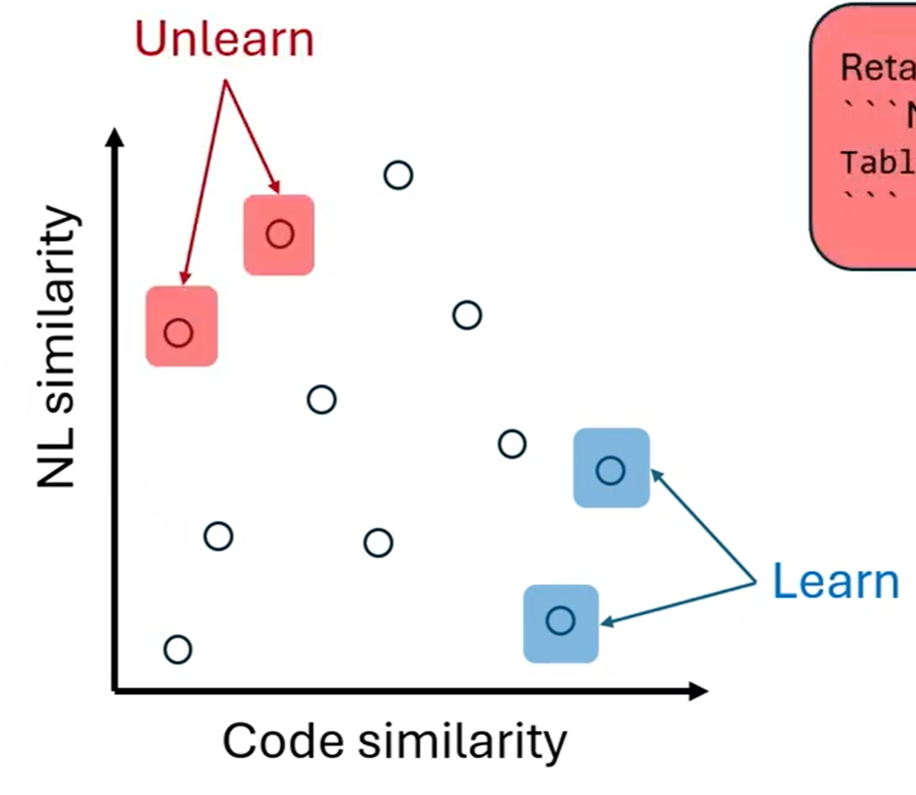

Target Similarity Tuning: Making it more efficient & effective
How to select a smaller number of samples for training?
How to handle out-of-distribution language ?
Fine-tuned sentence BERT
Add few dense layers to LLM embeddings
[EMNLP Findings 2023: TST^{R}: Target Similarity Tuning Meets the Real World]

Slide 8
Defining Code Similarity based on Properties
Code similarity based on tree-edit distance.
Code similarity based on properties (like method names, use of regex, …)
Wrong regular expression syntax.
Remove letters ‘a’ and ‘z’
Text.Delete(_, {‘a’, ‘z’))
Text.Delete(_, {‘a’ -‘z’))
LLM
Remove all letters.
LLM
Replace digits by ‘x’.
Text.Replace(_, {‘0’ .. ‘9’), ‘x’)
Text.Delete(_, {‘a’ .. ‘z’))
[Under Submission: Cooper: Learning what to teach language models for code generation]

Slide 9
Example-based Documentation Selection
1.
Remove 1 character from the text value "ABEFC" at position 2.
Text.RemoveRange("ABEFC", 2)
Example Retriever
Remove characters from the text value "ABEFC" starting at position 2 until position 6.
3.
LLM
Text.RemoveRange("ABEFC", 2, 4)
Need to know that second arg is count.
Syntax:
Text.RemoveRange(text as nullable text, offset as number, optional count as nullable number) as nullable text
About:
Returns a copy of the text value text with all the characters from position offset removed. An optional parameter, count can by used to specify the number of characters to remove. The default value of count is 1. Position values start at 0.
2.
Doc Retriever
[Under Submission: RAR: Retrieval Augmented Retrieval for Code Generation in Low Resource Languages]

Slide 10
Lecture 4: Programming by Natural Language
Prompting
Example & Document selection for in-context learning
Improve instructions using Meta-Reflection

Slide 11
Task Domain: IaC Security Policy Verification
Check if the following policy is violated in the following code module
# Policy: "Ensure subnet is configured with a Network Security Group”
# Code
resource "azurerm_subnet" "gateway"{
name = "gateway"
virtual_network_name = azurerm_virtual_network.vNet.name
address_prefixes = ["10.0.2.0/24"]
security_group = ….
}
Expected response: Not Violated
GPT4 response: Not Violated

Slide 12
Model’s Self-Reflection on Failure
Check if the following policy is violated in the following code module
# Policy: "Ensure subnet is configured with a Network Security Group”
# Code
resource "azurerm_subnet" "gateway"{
name = "gateway"
virtual_network_name = azurerm_virtual_network.vNet.name
address_prefixes = ["10.0.2.0/24"] }
resource "azurerm_subnet_network_security_group_association" "gateway" {
subnet_id = "$(azurerm_subnet.gateway.id)"
network_security_group_id = "$(azurerm_network_security_group.gateway.id)“ }
Expected: Not Violated
GPT4 response: Violated
I see that there is a resource gateway of type "azurerm_subnet_security_group_association" that may be responsible for configuring the network security group for the subnet. I will take care of it in the future.
Model’s self-reflection on its failure:

Slide 13
Meta-Reflection: Reflect over Individual Self-Reflections and update Prompt Instructions
Meta-reflection Prompt
Learn from your past experiences and help to perform better in the future. Use the previous reflections about failures or success to update previous instructions.
I see that there is a resource gateway of type "azurerm_subnet_security_group_association" that may be responsible for configuring the network security group for the subnet. I will take care of it in the future.
I see that there is a resource gateway of type "azurerm_subnet_security_group_association" that may be responsible for configuring the network security group for the subnet. I will take care of it in the future.
I see that there is a resource gateway of type "azurerm_subnet_security_group_association" that may be responsible for configuring the network security group for the subnet. I will take care of it in the future.
I see that there is a resource gateway of type "azurerm_subnet_security_group_association" that may be responsible for configuring the network security group for the subnet. I will take care of it in the future.
Updated Instructions:
…
4. Remember that the association between a subnet and a Network Security Group may not be direct. It could be done through a separate resource block such as "azurerm_subnet_security_group_association". Check these associations as well.

Slide 14
Meta-reflection results
Dataset | GPT4 | After meta-reflection
Biosses | 70 | 84
Casual Judgement (BIGBENCH) | 74 | 77
Epistemic Reasoning (BIGBENCH) | 70.8 | 88.4
Temporal Sequence (BIGBENCH) | 98 | 99.1
IaC Vulnerability detection | 73.4 | 90.2
HotPotQA | 43.7 | 55
[Under Submission: METAREFLECTION: Learning Instructions for Language Agents using Past Reflections]

Slide 15
Lecture 4: Programming by Natural Language
Prompting
Example & Document selection for in-context learning
Improve instructions using Meta-Reflection
Post-processing Techniques
Constrained Semantic Decoding

Slide 16
Constrained Semantic Decoding (CSD)
SELECT City
FROM Flights AS T1 JOIN Airports AS T2
ON T1.AirportCode = T2.SourceAirport
GROUP BY City
ORDER BY COUNT(*) DESC LIMIT 1
Which city has the highest number of departing flights?
GPT3
No Column “AirportCode” in table aliased as T1
[ICLR 2022: Synchromesh: Reliable code generation from pre-trained language models]

Slide 17
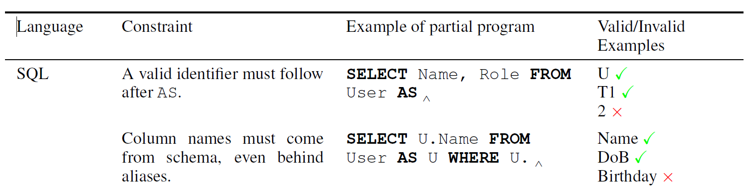
Constrained Semantic Decoding (CSD)
Decode/generate tokens iteratively, bias towards tokens that conform to underlying constraints.
Syntactic
constraint
Semantic
constraint
[ICLR ′22]
[ICLR 2022: Synchromesh: Reliable code generation from pre-trained language models]

Slide 18
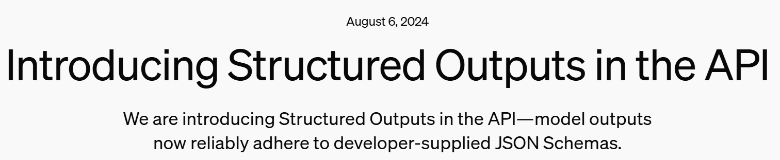
Constrained Semantic Decoding (CSD)
SELECT City
FROM Flights AS T1 JOIN Airports AS T2
ON T1.AirportCode = T2.SourceAirport
GROUP BY City
ORDER BY COUNT(*) DESC LIMIT 1
Which city has the highest number of departing flights?
GPT3
No Column “AirportCode” in table aliased as T1
GPT3
with CSD
SELECT City
FROM Flights AS T1 JOIN Airports AS T2
ON T1.AirportCodeSourceAirport = T2.AirportCode
GROUP BY City
ORDER BY COUNT(*) DESC LIMIT 1
[ICLR 2022: Synchromesh: Reliable code generation from pre-trained language models]

Slide 19
Lecture 4: Programming by Natural Language
Prompting
Example & Document selection for in-context learning
Improve instructions using Meta-Reflection
Post-processing Techniques
Constrained Semantic Decoding
Generate & Rank
Generate & Search

Slide 20
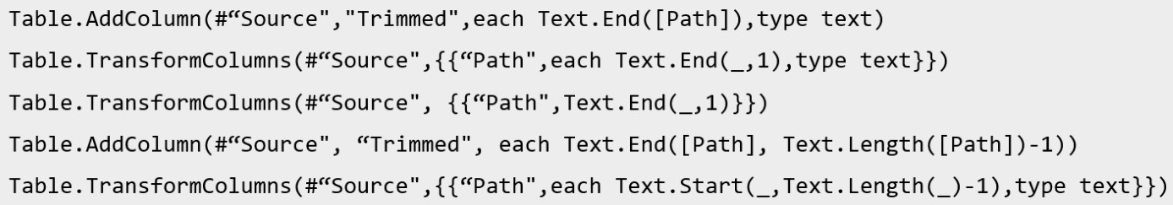
NL-to-Code as Generate & Rank using Examples
Predict task output on data sample; then validate/rank candidates.
Trim the end of all contents in column “dir” by one character.
LLM
/Account/
/Retrieve/
/Hello/
/Test/
/Account
/Retrieve
/Hello
/Test
LLM
[Under Submission: From words to code: harnessing data for program synthesis from natural language]

Slide 21


NL-to-Code using Examples as additional spec
A regex synthesis task.
At least one digit, followed by a colon at most once, followed by a digit at least zero times
NL desc.
Target regex
12345:6789
123
:12
Abc
[0−9]+:?[0−9]∗
Examples

Slide 22
Generate using NL & Search using Examples
GPT3 candidates
( [0−9]∗.. :( [0−9]∗)?)+
( [0−9]+: [0−9]?)∗
( [0−9]+:)?[0−9]?
( [0−9]∗ ( [:] [0−9]∗))∗ (0[0−9]+ )
( [0−9]∗ .. :∗[0−9]∗ 0∗)∗
( [0−9]∗.. :( [0−9]∗)?)+
( [0−9]+: [0−9]?)∗
( [0−9]+:)?[0−9]?
( [0−9]∗ ( [:] [0−9]∗))∗ (0[0−9]+ )
( [0−9]∗ .. :∗[0−9]∗ 0∗)∗
GPT3 on NL spec:
Target regex
None of GPT3 candidates is correct.
But it prominently contain components of target regex.
[0−9]+:?[0−9]∗
[0−9]+:?[0−9]∗
PBE on example spec:
PBE overfits or doesn’t scale with lots of examples.
Idea:
Bias PBE search + ranking using
component distribution from GPT3 candidates.
[OOPSLA 2021: Multi-modal program inference: a marriage of pre-trained language models and component-based synthesis]
[OOPSLA ′21, Rahmani et al, Multi-modal program inference: a marriage of pre-trained language models & component-based synthesis]

Slide 23

Lecture 4: Programming by Natural Language
Prompting
Example & Document selection for in-context learning
Improve instructions using Meta-Reflection
Post-processing Techniques
Constrained Semantic Decoding
Generate & Rank
Generate & Search
Datasets and Evaluation
Synthetic Data Generation
Multiple correct outputs

Slide 24
Synthetic Data Generation for NL2Code
FirstName | LastName | Output
Joe | Doe | Joe-Doe
Sally | Jaikel | Sally-Jaikel
Arun | Thomson | Arun-Thomson
Challenge: Obtain correct NL descriptions from code
CONCATENATE(@[FirstName],
‘-’, @[LastName])
Validator 1: Generate Output from utterances using LLM.
Validator 2: Generate Python code from utterances using LLM and execute Python code to generate Output.
Generate Utterances from Formula using LLM.
John Doe
Sally Jaikel
Arun Thomson
John Doe
Sally Jaikel
Arun Thomson
df[‘FirstName’].str.cat(df[‘LastName’],sep=‘-’)
Concatenate first name and last name.
Insert a dash between the first name and last name.
John-Doe
Sally-Jaikel
Arun-Thomson
John-Doe
Sally-Jaikel
Arun-Thomson
df[‘FirstName’] + ‘ ’ + df[‘LastName’]
[Under Submission: An Empirical Study of Validating Synthetic Data for Formula Generation]

Slide 25
NL2Code Evaluation: Multiple correct outputs
Challenge in MBPP dataset: Input/Output type signatures are not specified
Key Idea: Generate multiple sets of assertions
validator
assert f('aab_cbbbc ') == True
...
# filter
assert f([ 'aab_cbbb ', 'aab_Abbbc ']) == ['aab_cbbb ']
...
# extractor
assert f('01 aab_cbbbc 23 ') == 'aab_cbbbc '
...
Write a function to find sequences of lowercase letters joined with an underscore.
assert f('aab_cbbbc ') == 'Found a match !’
assert f('aab_Abbbc ') == 'Not matched !'
assert f('Aaab_abbbc ') == 'Not matched !'
[Under Submission: One-to-many testing for code generation from (just) natural language]

Slide 26
Opportunities
Natural Language is desirable not just as Input but also as:
Output
  Program explanation
  Hint generation
  What constitutes a good explanation, hint?
Conversation
  Ambiguity Resolution with user
    Leverage good conversation principles. [1]
    How to (automatically) evaluate and improve conversation quality? [2]
1. [VLHCC 2024: Let’s Fix this Together: Conversational Debugging with GitHub Copilot]
2. [AIWare 2024: RUBICON: Rubric-based Evaluation of Domain Specific Human-AI Conversations]

Slide 27
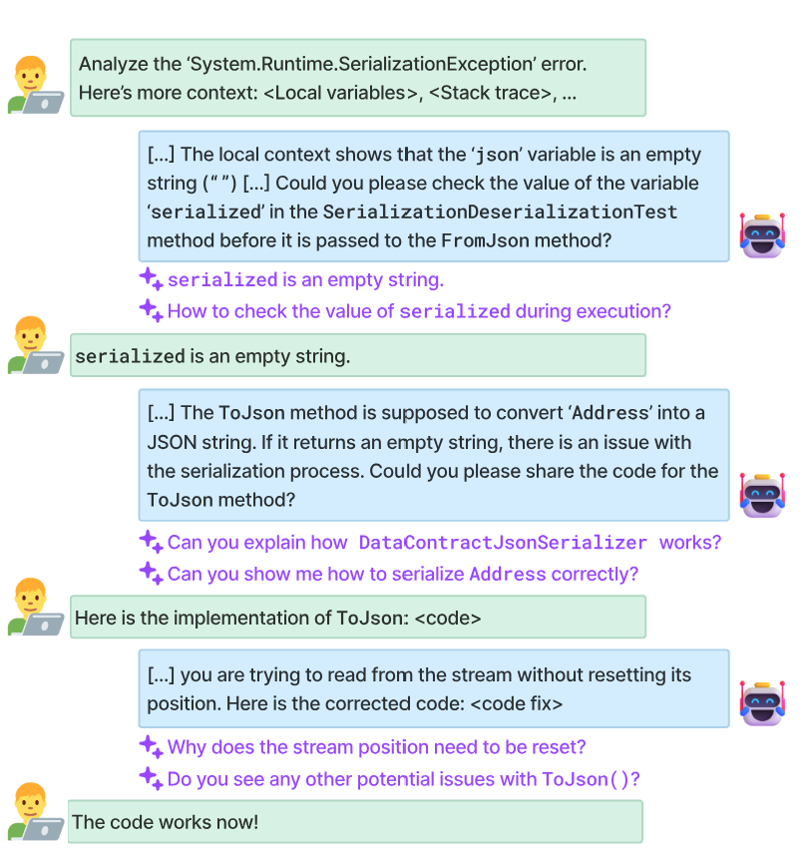
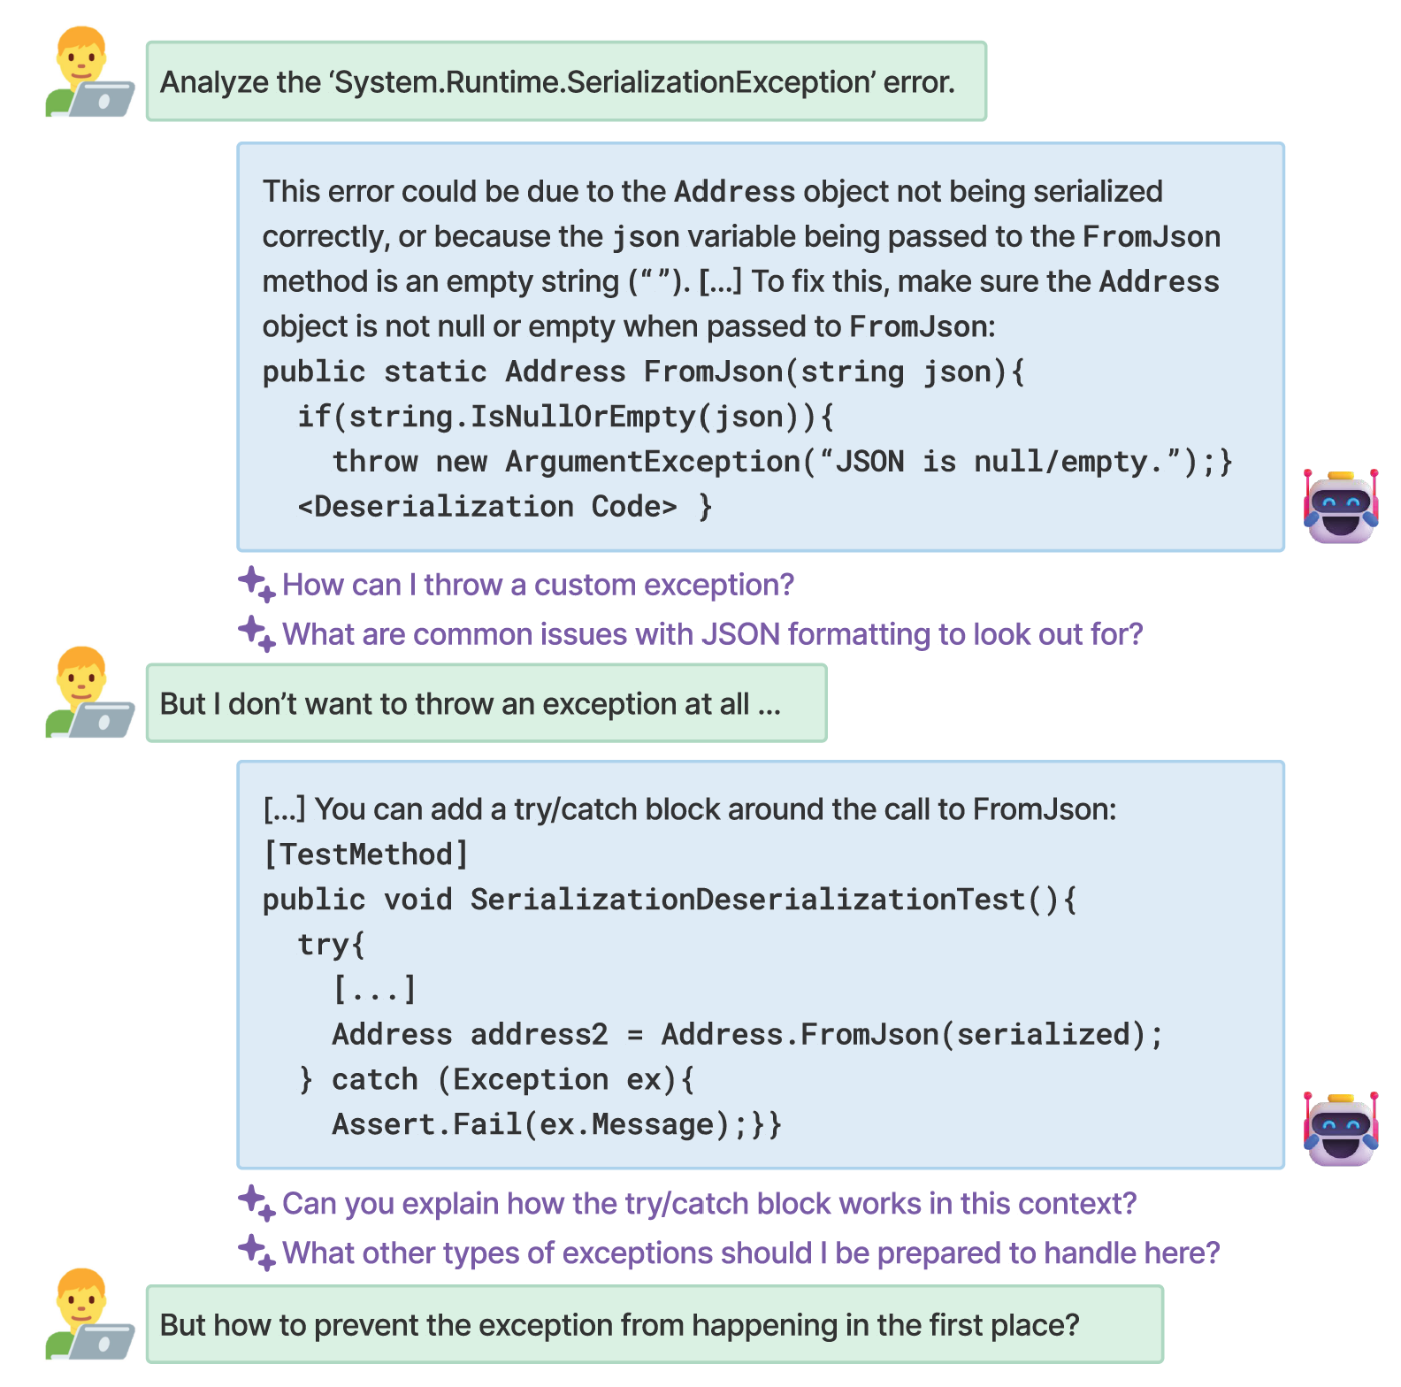
Bad vs. Good Conversations

Slide 28
How to evaluate and facilitate good conversations
We searched for Principles of Effective Communication in social sciences literature.
Gricean Maxims
Maxim of Quality
Only presenting true/factual information
Maxim of Relevance
On track conversation, avoid discontinuity.
Maxim of Quantity
Not contributing more, or less, than required
Maxim of Manner
Being clear, concise and orderly.

Slide 29
Opportunities
Natural Language is desirable not just as Input but also as:
Output
  Program explanation
  Hint generation
  What constitutes a good explanation, hint?
Conversation
  Ambiguity Resolution with user
    Leverage good conversation principles. [1]
    How to (automatically) evaluate and improve conversation quality? [2]
  Think, Plan, Reflect => Agentic Architectures
1. [VLHCC 2024: Let’s Fix this Together: Conversational Debugging with GitHub Copilot]
2. [AIWare 2024: RUBICON: Rubric-based Evaluation of Domain Specific Human-AI Conversations]

Slide 30
Opportunities
Prompting as a new programming paradigm.
Prompt Synthesis
  Smart example/document selection
  Meta-reflection for improving prompt instructions
Prompt Maintenance
  What part of a prompt affects an input? (for bug localization)
  What tests are sensitive to a prompt instruction? (regression prediction)

Slide 31
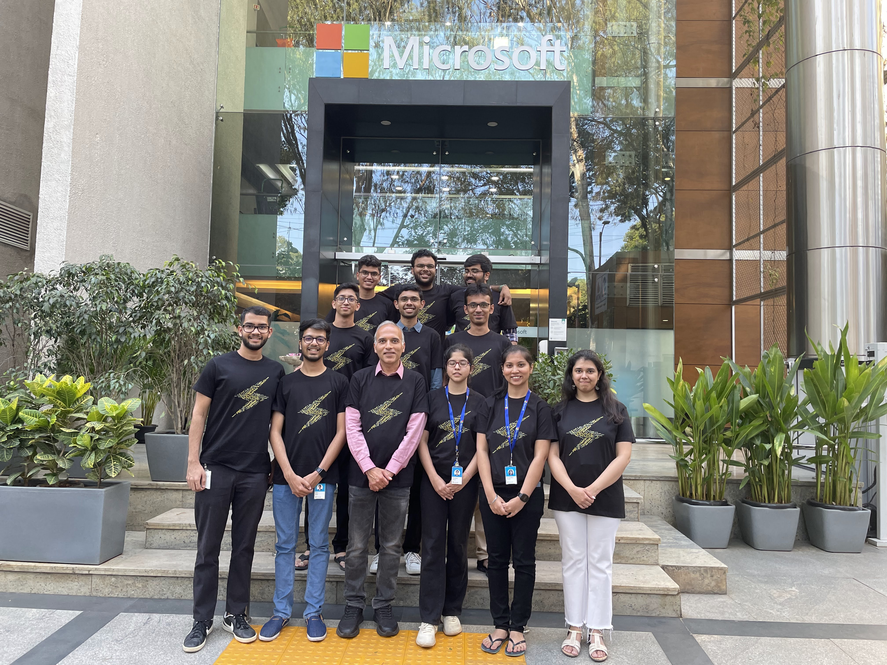
PROSE
Research Fellows
India

Slide 32
CONCLUSION

Slide 33
Intent Specification
If you insist on complete and formal/logical spec, you will miss out!
Examples, being verifiable, are a very special form of specification.
  Enable use of backtracking-based search or failure-guided refinement techniques.
  NL and Predictive tasks can often be reduced to examples.
  NL and Repair tasks are often augmented with examples.
Temporal Context can contain user intent.
Opportunities
Develop techniques, experiences for multi-modal specifications.
Image/Video as input.

Slide 34
Applications
String Transformations (syntactic and semantic)
Table Extraction (text files, webpages, PDF/images)
Code Edits
Accessibility (not just Productivity)
Code Repair
Education
Next Action prediction (Action transformer)
App Creation
Robotics

Slide 35
User Experiences
Distinguishing Inputs for finding representative inputs
Smart Copy Paste
Leverage temporal context
Investigate and Respond pattern to facilitate interactive conversation
Generate hints instead of repair

Slide 36
Neuro-Symbolic Techniques
Logical reasoning provides correctness, regularity, inspectability.
ML techniques provide:
  Biases for search and ranking heuristics.
  Semantic/world knowledge for transformations, variable renaming
  Natural language understanding
Different ways to combine logical reasoning and machine learning.

Slide 37
Neurosymbolic architectures in this talk
Symbolic Model
Symbolic Model
Hints
Hints
Neural Model
Neural Model
Out
I
In
Technology​ | Help provided by symbolic model​ | Reference
Synchromesh (post-processing) | Constrained Semantic Decoding | ICLR ’22; Synchromesh: Reliable code generation from pre-trained language models.
PBE using LLMs | Execution-aware Semantic Decoding | Under Submission
37

Slide 38
Neurosymbolic architectures in this talk
Neural Model
Hints
Symbolic Model
Out
In
Technology​ | Hints provided by neural model​ | Reference
FlashFill++​ (readable code generation for string transformations) | Search and Ranking heuristics, Meaningful variable names​ | POPL ’23; FlashFill++: Scaling Programming by Example by Cutting to the Chase.
Excel/PowerFx Formula Repair​ | Error localization, Ranking​ | OOPSLA ’22; Neurosymbolic repair for low-code formula languages.
38

Slide 39
Neurosymbolic architectures in this talk
Neural Model
Symbolic Model
In
Out
Technology​ | Neural / Symbolic​ | Reference
Regex synth from NL+Examples | Components / Composition | OOPSLA ‘21; Multi-modal program inference: a marriage of pre-trained language models and component-based synthesis.
Predictive Table Extraction | Example generation / Program Synthesizer | CIKM ‘24: Tabularis Revilio: Converting Text to Tables
39

Slide 40
Neurosymbolic architectures in this talk
Symbolic Model
In
Out
Neural Model
Technology​ | Symbolic / Neural​ | Reference
Semantic FlashFill | Syntactic / Semantic transformation | OOPSLA ’21; Semantic programming by example with pre-trained models.
Semantic Code Edits | Sketch / holes | FSE ’23; Grace: Language Models Meet Code Edits.
40

Slide 41
A perspective on Large Language Models
Imprecise/approximate form of computation.
Opportunities to build validation techniques or failure-driven refinement techniques.
Can be seen as effective heuristics
  They also provide an easy way to implement desired heuristics.

Slide 42




AI-assisted Programming
Broad range of users
Developers
Data Scientists
Low-code users
Students
Education in severe need for disruption!
LLMs are powerful.
So are grammar-based symbolic techniques.
Great opportunities for creative neuro-symbolic architectures!
Different ways to express intent:
Examples
NL
Temporal context
sloppy program
UX important for adoption, motivates foundational problems.
sumitg@microsoft.com
@sumitgulwani

