Slide 1
TxMiner:
Identifying Transmitters in Real World Spectrum Measurements
Mariya Zheleva
University at Albany, SUNY

Slide 2
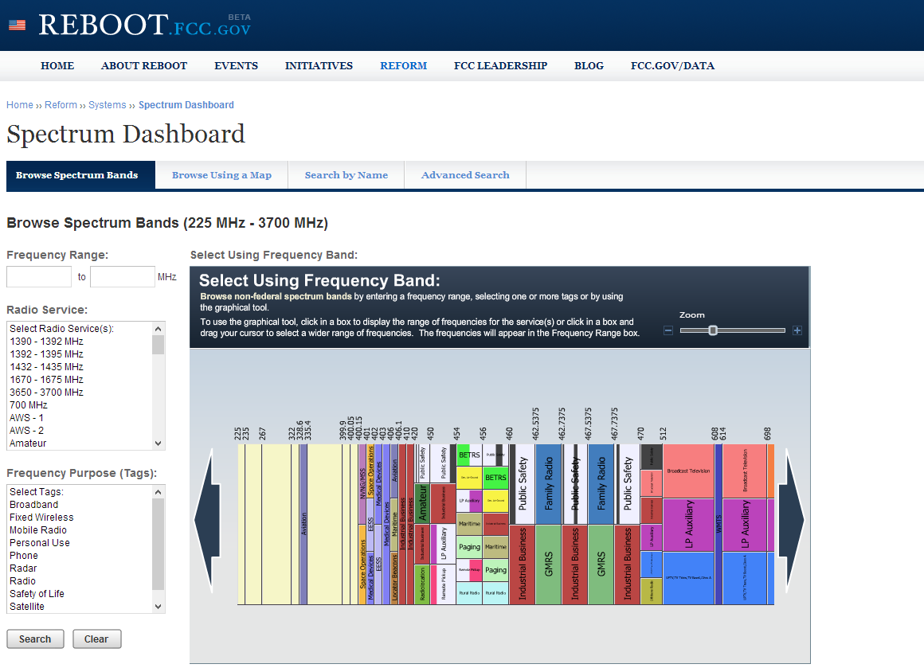
Spectrum Allocation
100%

Slide 3
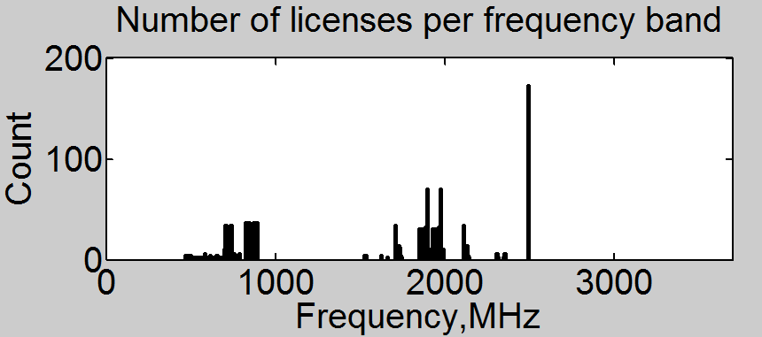
Spectrum Assignment (in Washington State)
According to FCC dashboard:
  A total of 2498MHz (77.3%) appear unassigned.
  Assignments are granted to 88 unique entities in Washington.
  50% of all licenses are owned by 10 companies.
14.7% New Cingular Wireless PCS
8.9% AT&T Mobility
6.8% T-Mobile License
6.6% Cellco Partnership
5.8% Verizon Wireless
4.2% Clearwire Spectrum Holdings
2.9% American Telecasting Development
2.1% Seattle SMSA Limited Partnership
2.1% Cricket License Company
1.8% NSAC
Broadband
and
Educational
Radio Services
(BRS and EBS)
PCS Cellular
1700-2200MHz
Cellular 628-960MHz
Cellular 698-902MHz
UHF TV
Source: http://www.fcc.gov/developers/spectrum-dashboard-api

Slide 4
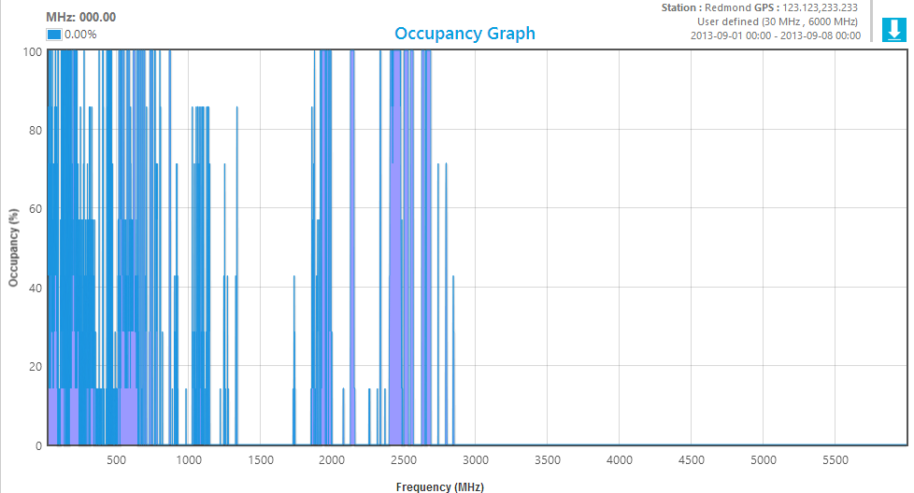
Occupancy
How much spectrum is occupied?
How good is the available spectrum for DSA?
  What transmitters are occupying the spectrum?
??%

Slide 5
Why Do We Care About Occupancy?
Help regulators, e.g. FCC, to open up additional spectrum:
  Who is using the spectrum?
  How much bandwidth can the system get using DSA?
Help interested parties make a case for release of DSA spectrum.
Inform DSA techniques in different spectrum bands:
  Which bands are continuously available and which are periodically available?
    What implications would the type of availability have on DSA devices.
  Will spectrum sensing work?
  How accurate is a geo-location database?
  How much interference will it cause on the primary user?
Policy
Technology

Slide 6
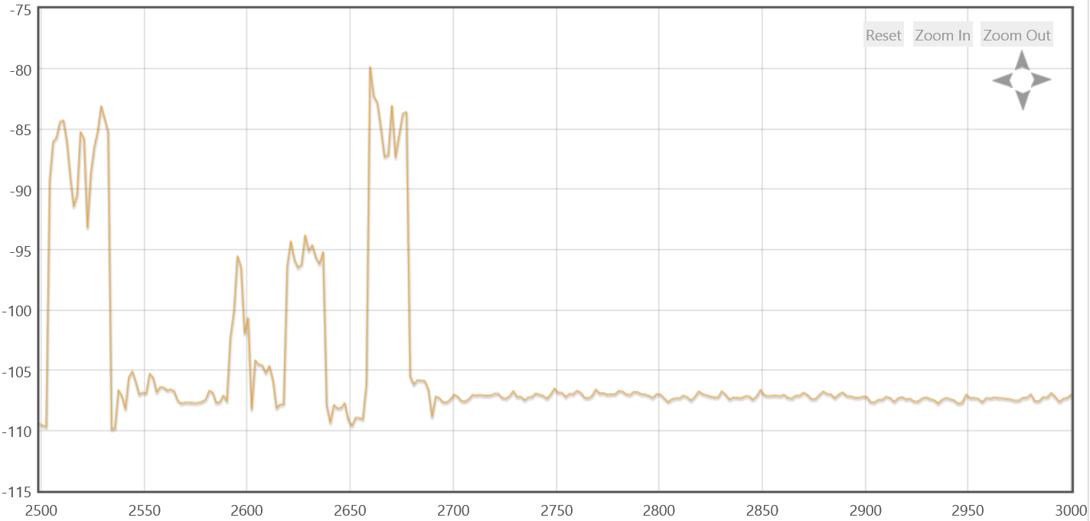
TxMiner Goal
Power Spectral Density Graph
Transmissions:
  Center frequency
  Number of transmitters
  Bandwidth
  TDMA/FDMA
  Mobility
  Direction
PSD, dBm/Hz
Frequency, MHz

Slide 7



TxMiner Applications
TX periodicity
TX bandwidth
Mobile TX over time
Primary or Secondary
3) Bandwidth X
satisfies user
demand
1) Spectrum availability?
2) Spectrum availability +
Transmitter Characteristics
TxMiner-enhanced
DSA Database
Secondary User
Network
Geo-location
database

Slide 8
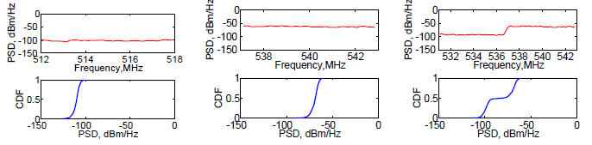
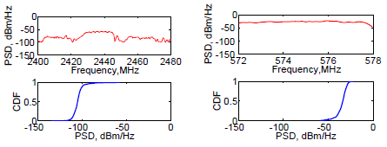
Key Insight
Measured signal distributions tell us about channel occupancy.
Stationary sensor. Wide-range TV broadcast service.
Stationary sensor.
Short-range
frequency-hopping
transmission.
Mobile sensor.
Wide-range TV
broadcast service.

Slide 9
Key Insight
Measured signal distributions tell us about channel occupancy.
Idle TV channel
  Mean -108dBm
Occupied TV channel
  Mean -70dBm
Two occupied TV channels
  Bimodal distribution
Bluetooth
  Long tail at high PSD
Mobile transmitter
  Large variation
  Stationary: Δ=10dBm
  Mobile: Δ=25dBm

Slide 10
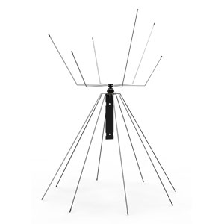
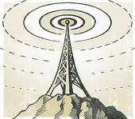
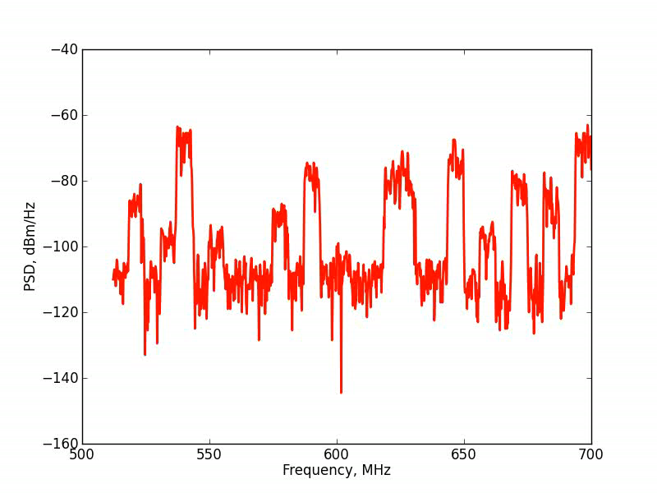
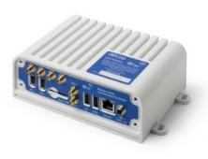
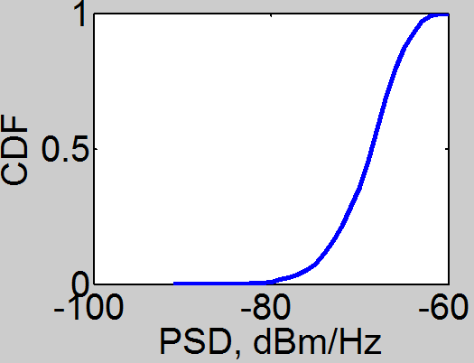
Key Insight
Why a Distribution?

Slide 11
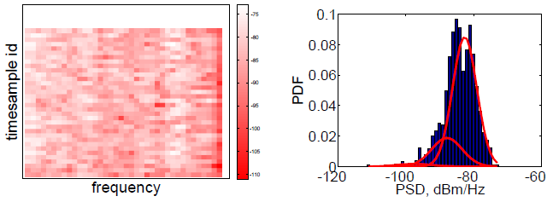
Gaussian Mixture Models
Unsupervised machine learning.
Captures sub-populations in a
given population.
Fit goodness based on
minimization of BIC (Bayesian
Information Criterion).
Each Gaussian is characterized with a weight ω_{g}, a mean µ_{g} and a variance σ_{g}:
  ω_{g} – how represented is a Gaussian in the measured data
  µ_{g} – the mean of the measured signal
  σ_{g} – the variance of the measured signal
Measured PSD over
frequency and time.
A histogram of measured
signal with fitted Gaussians
as per GMM.

Slide 12
Mining Transmitters
Ready to extract some transmitters?
Post-processing is necessary to:
  Determine components due to the same transmission.
  Extract transmitter characteristics.
More than one Gaussian per transmitter.

Slide 13
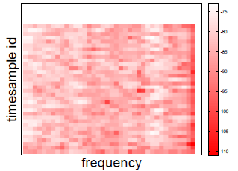
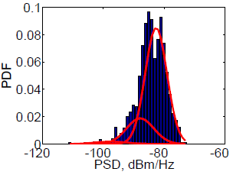
Mining Transmitters: Algorithm
From raw PSD to GMM
Noise floor
Anticipated transmissions
GMM
Transmitter signature extraction
Mine transmitters
Extract signatures
Smooth association probabilities
Association probabilities

Slide 14


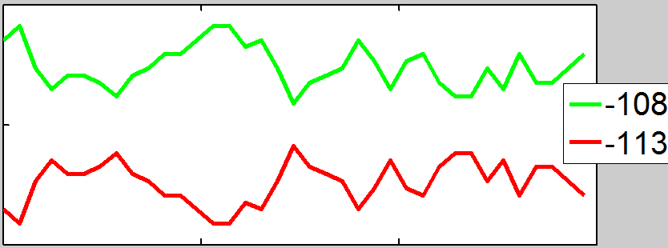
Transmitter Signature Extraction
3D space (time, frequency, PSD)
Time
Frequency
2D space (frequency, Signature)
Same signature => same transmitter
Frequency

Slide 15

Evaluation
TxMiner implemented in MATLAB.
Evaluation goals:
  Accuracy in occupancy detection.
  Transmitter count and bandwidth.
  Comparison with edge detection.

Slide 16
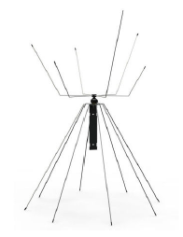

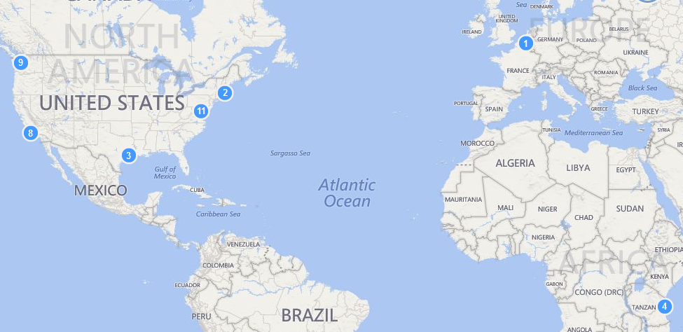
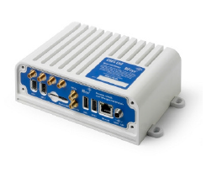
Measurement Setup
RfEye spectrum scanner
manufactured by CRFS*.
Multi-polarized Rx antenna
25MHz – 6GHz.
* http://www.crfs.com/products/rf-sensor-rfeye-node/

Slide 17


Data
Ground truth – detection of known transmitters:
  TV-UHF.
  Combined with FCC CDBS, AntennaWeb, TVFool and Spectrum Bridge.
Controlled – detection of custom transmitters:
  WiMax using 1.75MHz, 3.5MHz and 7MhHz bandwidth.
Artificially mixed signals.

Slide 18
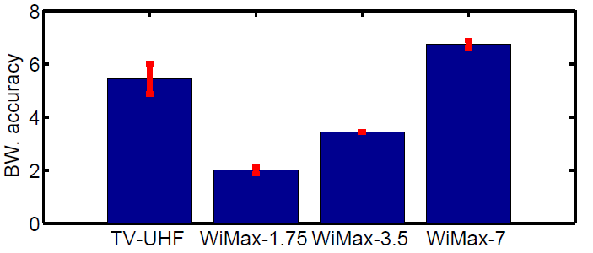
Bandwidth Detection
Detected Bandwidth, MHz

Slide 19
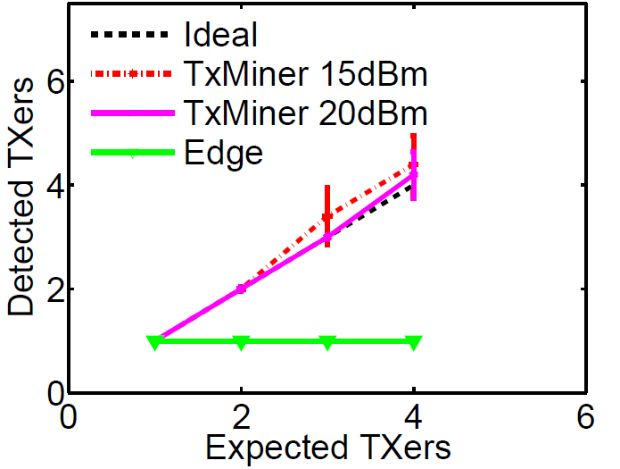
Detection of Multiple Transmitters

Slide 20
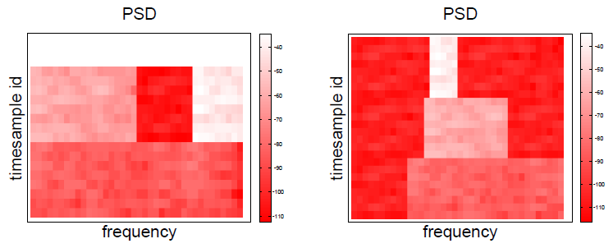
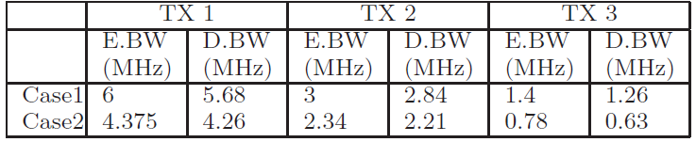
Detection of Multiple Transmitters
Multiple transmitters with variable bandwidths
Case 1
Case 2

Slide 21
Conclusion and Future Outlook
TxMiner successfully detects key transmitter characteristics.
An integral component that enables:
  DSA beyond TV White Spaces.
  Better regulation of DSA spectrum.
  Spectrum regulation in developing countries.
Avenues for improvement:
  Channel modeling beyond log-normal (e.g. Rayleigh in fast-fading conditions).
  Detection of mobile transmitters.
  Integration with known transmitter signatures.

Slide 22
Thank you! Questions?
Mariya Zheleva
mjeleva@gmail.com

